Slide 1
PLUGIN MAP GENERATOR UNTUK PEMBUATAN DUNIA 3D DALAM GAME
Georgius Bagas Wicaksono (4210161025)

Slide 2
Background
Plugin in modern era
Use of Plugins
Plugin Performance

Slide 3
AIMS
Detailed Model
Less Memory Usage
Create a 3D Game World
Easily To Operate
Not From The Scratch

Slide 4
Just For Unity
Not Include Object (Animals / Building/ ETC)
Scope Of Problem

Slide 5
Literature review
Octave
Noise Mapping
Amplitude
Frequency

Slide 6
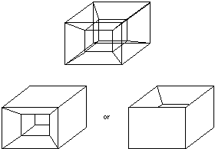
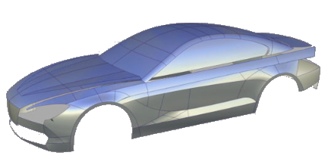
Curves

Slide 7
Decrease Number of Polygon
Level Of Detail
To Draw Object
Create Model Architecture

Slide 8
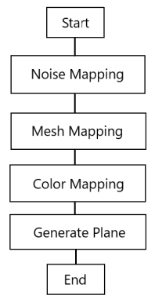
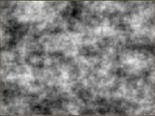
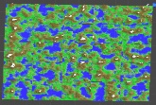
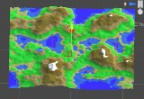
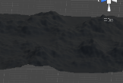
methodology

Slide 9
Test Result
No. | Parameter | PC (Low End)
 |  | Nilai Pengujian | CPU Usage | Memory Usage
1 | Value Level Of Detail | 6 | 60 FPS | 0.52 GB
2 | Noise Scale | 1000 | 60 FPS | 0.57 GB
3 | Persistence | 1 | 60 FPS | 0.58 GB
4 | Lacunarity | 2 | 60 FPS | 0.58 GB
5 | Seed | 800 | 60 FPS | 0.57 GB
6 | Mesh Height | 80 | 60 FPS | 0.61 GB

Slide 10
No. | Parameter | Macbook Pro 2018 (HIGH END)
 |  | Nilai Pengujian | CPU Usage | Memory Usage
1 | Value Level Of Detail | 0 | 100 FPS | 0.81 GB
2 | Noise Scale | 100 | 100 FPS | 0.96 GB
3 | Persistence | 1 | 100 FPS | 1.14 GB
4 | Lacunarity | 4 | 100 FPS | 1.03 GB
5 | Seed | 50 | 100 FPS | 0.99 GB
6 | Mesh Height | 100 | 100 FPS | 1.22 GB

Slide 11
Conclusion
Goal = Desired Plugin
(Achieved)
Easily To Use
Satisfactory Performance
Less Memory Usage

